Slide 1

BANK ANALYTICS Project : Bank loan of customers Domain : Finance
Team Members:
Aakesh Dhanawade

Slide 2
Understanding Bank Loans
Introduction to Bank Loans
Bank loans are a fundamental financial instrument offered by financial institutions worldwide.
They provide individuals and businesses with access to funds for various purposes.
This presentation delves into the key aspects of bank loans, their significance, and their impact on borrowers and lenders.
Why Bank Loans Matter
Bank loans play a pivotal role in the economy, driving growth, and facilitating financial stability.
They empower individuals to realize personal aspirations (e.g., homeownership, education) and enable businesses to expand and innovate.
Understanding bank loans is essential for making informed financial decisions and for the sustainable development of the financial sector.

Slide 3




Tools Used

Slide 4

Inception of Data
Total Number of Loan Accounts- 39717
The Total Loan amount-$445,602,650
Loan Tenure-30 &60 Month
Avg interest rate-12.02%
The total revolutionary balance-39717

Slide 5
Data Description:
The provided dataset contains information about bank loans. It encompasses various attributes associated with loan applicants, their credit histories, loan terms, repayment specifics, and other pertinent data.
The dataset covers factors such as the number of delinquencies, inquiries, credit utilization, loan amounts, interest rates, loan grades, borrower employment details, annual incomes, loan issuance dates, loan statuses, and more. These attributes collectively offer insights into the loan application process, borrower profiles, repayment behaviours, and loan performance.
Dataset Size: Each Excel file has 39k+ records

Slide 6

Analysis of Project KPIs Along with the datasets 5 KPIs are provided for analyzing the data.
Year wise loan amount
Grade-Subgrade wise revolution balance
Total Payment For Verified Status Vs Non -Verified Status
State Wise Last credit pull _d Wise Loan Status
Home Ownership Vs Last Payment Date Stats.

Slide 7
Project Purpose and Significance :
Here's why this project is crucial and significant
Strategic Insights for Informed Decisions: By analyzing loan amounts year-wise, the project provides an overview of changing borrowing patterns. This data informs financial institutions about peak demand periods and helps them allocate resources effectively, ensuring timely and competitive loan offerings.
Risk Assessment and Portfolio Management: Visualizing sub-subgrade-wise revolving balances enables institutions to assess credit utilization
patterns among different borrower segments. This insight guides risk assessment strategies and supports effective management of loan portfolios, ensuring balanced risk exposure.
Verification Status Analysis: Differentiating between "verified" and "not verified" loans gives insights into the institution's reliance on verified borrower information. This analysis is essential for ensuring prudent lending decisions, minimizing potential risks associated with unverified data.
Regional Loan Performance: Examining loan statuses across states based on last credit pull dates offers geographical insights into loan performance. This information helps institutions tailor their lending strategies to specific regions, ensuring targeted risk management and
responsive borrower support.
Enhanced Operational Efficiency: The dashboard's consolidated view of critical KPIs empowers institutions to streamline operations. By optimizing processes, institutions can allocate resources efficiently, reduce operational redundancies, and enhance overall efficiency, leading to cost savings and improved customer experiences.

Slide 8
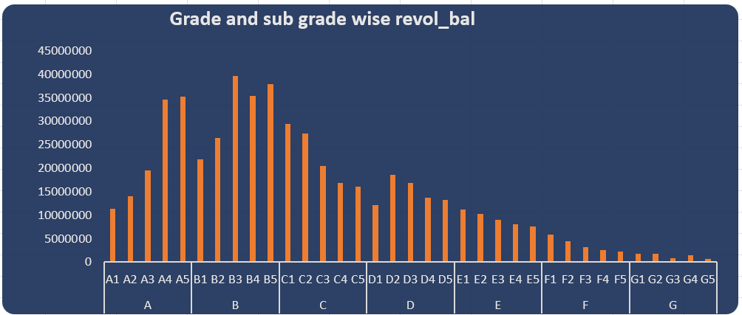
Excel Dashboard
KPI 2- Suggestions : Grade and Sub-Grade Wise Revolving Balance-
Analyze the performance of loans in Grade B and C to understand why they have the highest revolving balances. It might be necessary to adjust lending criteria for these grades.
Consider offering more attractive terms or incentives for loans in lower-performing grades like Grade
G to reduce the revolving balance.

Slide 9
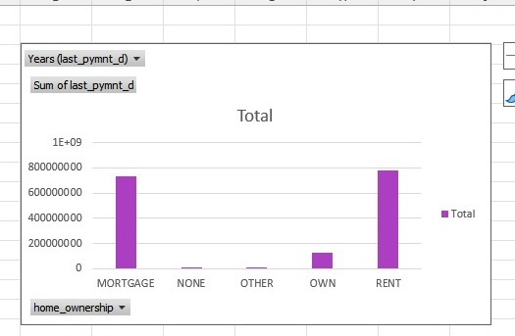
KPI 4,5 - Suggestions : Focus on understanding the factors contributing to charged-off loans in certain states and years. This could involve assessing the creditworthiness of borrowers in those areas. Consider offering incentives or promotions to borrowers with different home ownership statuses to encourage timely payments.

Slide 10
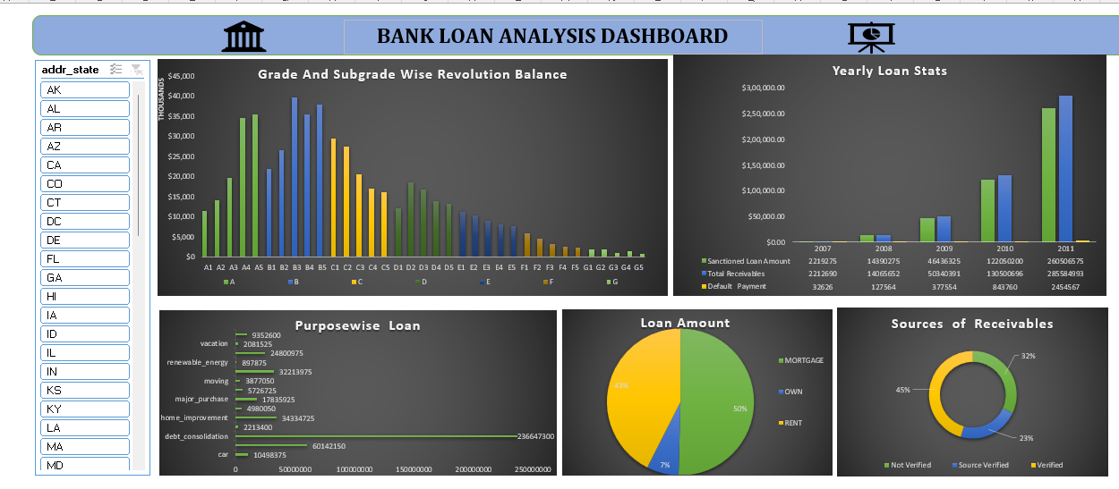

Slide 11
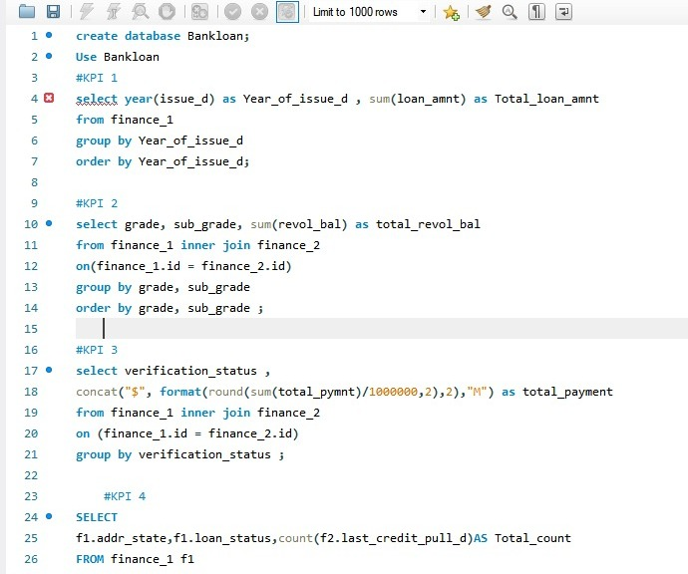
KPI 1 st to 3rd In MySQL-

Slide 12
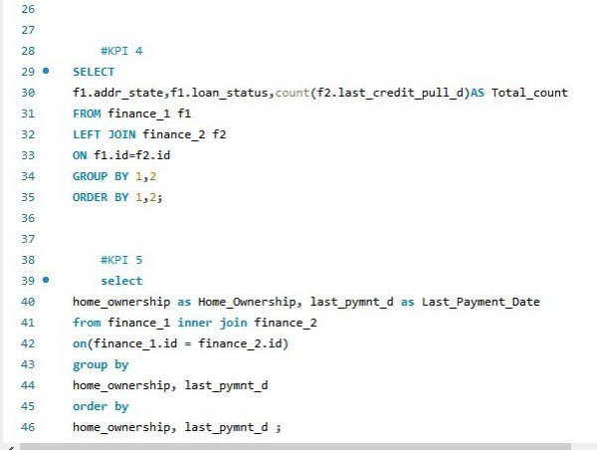
KPI 4 & 5 MySQL-

Slide 13
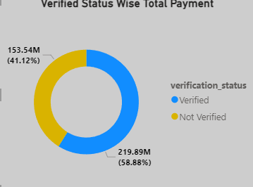
Power BI Dashboard
KPI 3- Suggestions :
Total Payment for Verified Vs. Non-Verified Status –
Examine the performance of verified vs. non-verified loans. If verified loans perform better, consider emphasizing verification in the lending process.
Ensure that the verification process is efficient to handle the large volume of verified loans

Slide 14
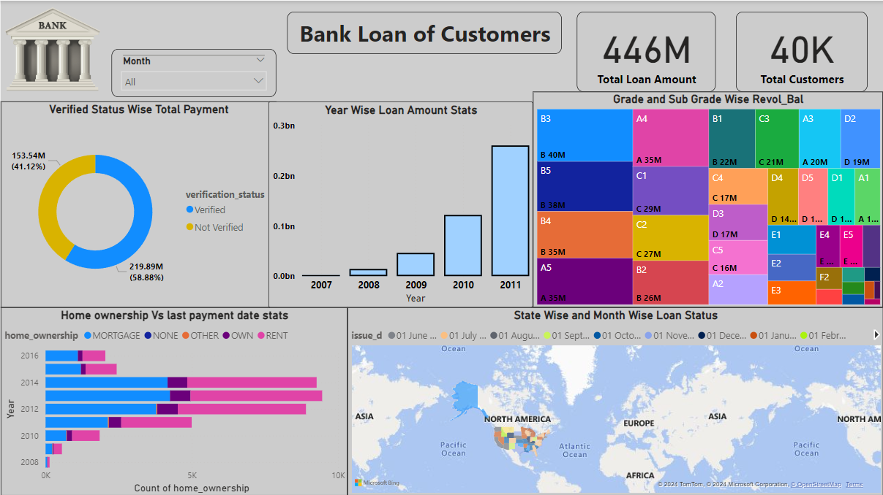

Slide 15
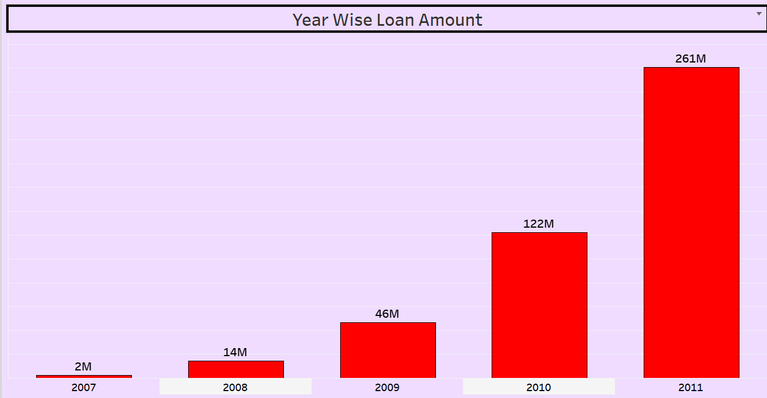
Tableau Dashboard
KPI 1-Suggestions: Investigate the reasons behind the significant increase in loan amount from 2009 to 2010. It could be due to increased demand or a change in lending policies.
Monitor the trend in loan amount issuance to ensure it aligns with the company's risk
tolerance and financial stability.

Slide 16
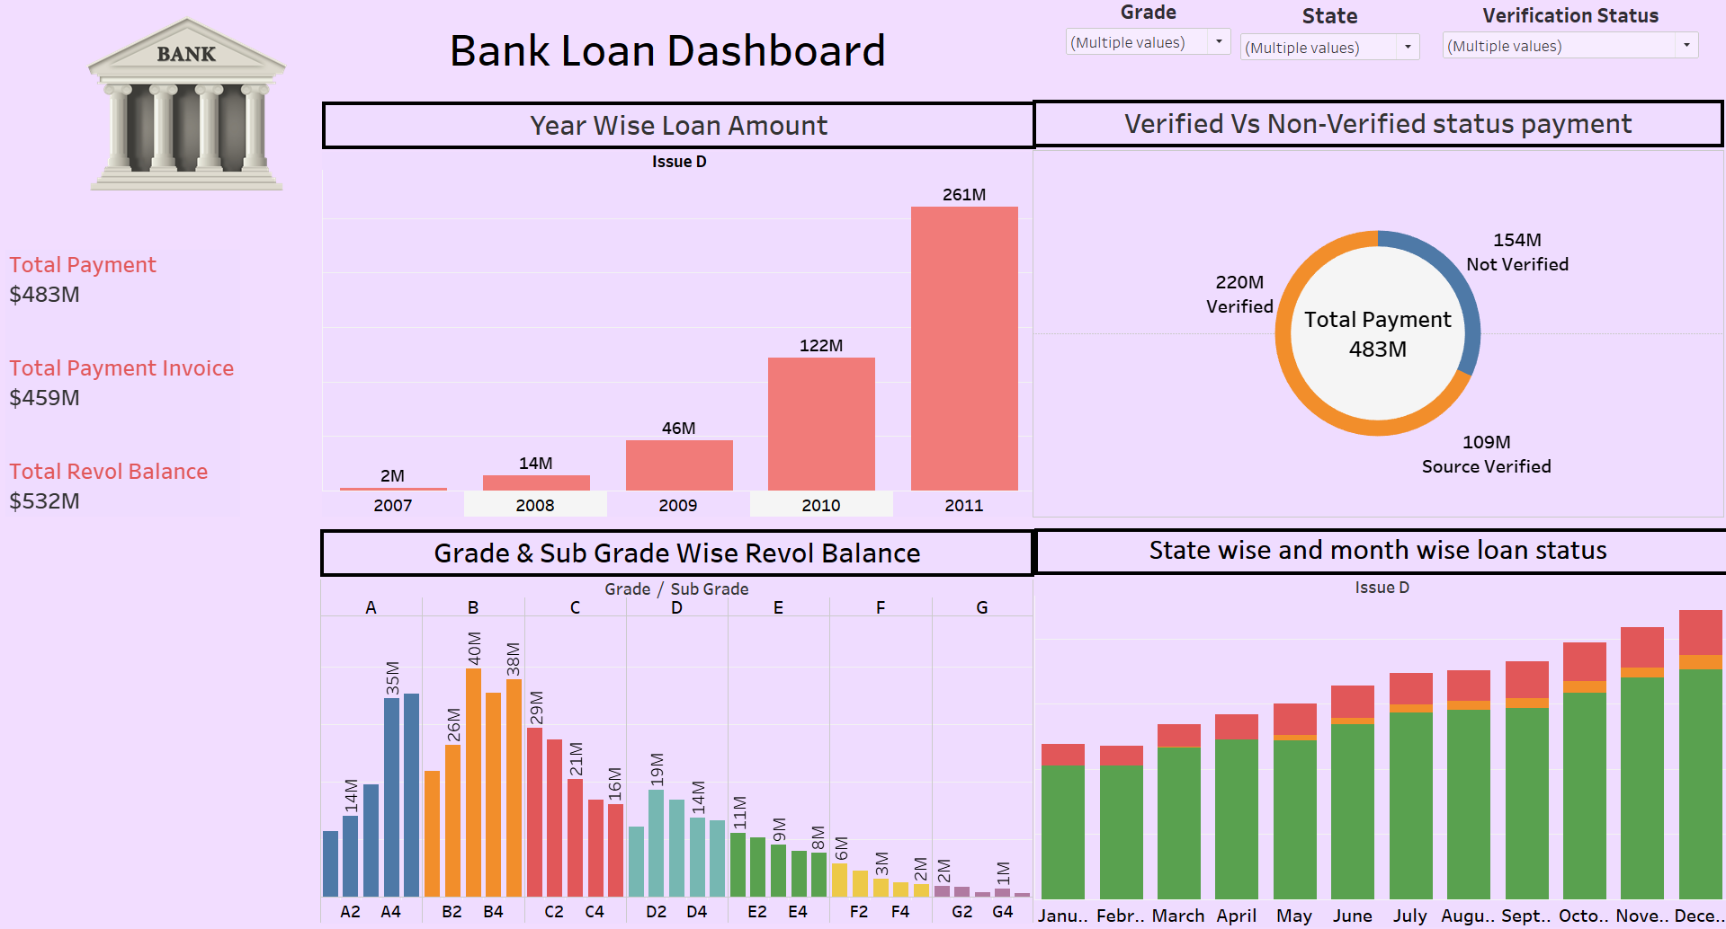

Slide 17
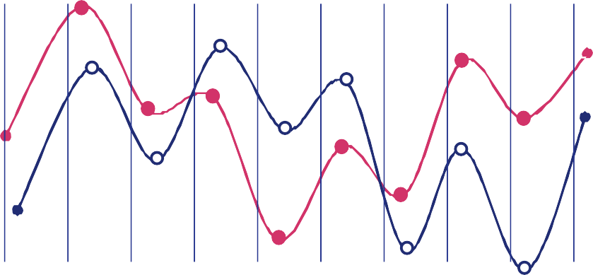
Conclusion
Regularly monitor and analyze these KPIs to identify trends and anomalies.
Use data-driven insights to make informed lending decisions and adjustments to lending policies.
Continuously evaluate and improve the verification and credit assessment processes to mitigate risks.
Stay responsive to changes in borrower demographics and market conditions to adapt lending strategies accordingly.

Slide 18


